Slide 1
Pre Diagnostic Quiz:
When will 1947 calendar repeat?
If 1st day is Wednesday . Then what will be 240th day?
If 1st April 2020 is Saturday. Then what will be the day on 26th august 2020?
On what day did Dr. A.P.J Abdul Kalam was born. (date of birth: 15.10.1931)
India got independence on 15th August 1947. On what day did it fall?

Slide 2

SECTION: NUMERICAL APTITUDE
TOPIC : CALENDARS
*THIS CAN BE A PART OF APTITUDE
& LOGICAL REASONING
Concept of calendars.
Year repetition.
Predicting the future day based on the given scenario.
Finding the day for a given date.
Facts about calendars.

Slide 3

month
CALENDARS
year
day
week
Leap year

Slide 4
Current calendar : Gregorian Calendar
The Gregorian calendar is today's internationally accepted civil calendar and is also known as the Western or Christian calendar.
One normal year = 365 days (52 weeks + 1 day)
leap year = 366 days (52 weeks + 2 day)
The leap year occurs once in 4 years.
To find the leap year:
Case 1: if the year is not a century year
Divide the last two digits of the year by 4 . If it is exactly divisible it is a leap year else it is not a leap year.
Case 2: If it is a century year (eg: 800,1100,1200.,)
1. Divide the year by 400 . If it is exactly divisible it is a leap year else it is not a leap year.

Slide 5
Concept of Calendars:
The concept of Calendars can be understood by calculating the “odd days”.
Odd days:
The odd days are calculated by taking the days which are left over after the complete week(s).
One week = 7 days
So if there are 50 days – it has 7 complete weeks + 1 day so 1 odd day
i.e to find the number of odd days we need to divide the value by 7 and take the remainder.
For 150 days – 150/7 – Remainder = 3 so 3 odd days.
*Calculating odd days will play a major role in the concept of Calendars.

Slide 6
Month | No.of.days | No.of.odd days
January | 31 | 3
February | 28/29 | 0/1
March | 31 | 3
April | 30 | 2
May | 31 | 3
June | 30 | 2
July | 31 | 3
August | 31 | 3
September | 30 | 2
October | 31 | 3
November | 30 | 2
December | 31 | 3
Odd day | Day
0 | Sunday
1 | Monday
2 | Tuesday
3 | Wednesday
4 | Thursday
5 | Friday
6 | Saturday

Slide 7
Year | Odd Day
100 years | 5 odd days
200 years | 3 odd days
300 years | 1 odd day
400 years | 0 odd day
How do we arrive at the odd days?
100 years means – 1 to 100 there are 24 leap years and 76 non leap years
We know leap year = 2 odd days, ordinary year = 1 odd day
So 24*2+76*1 = 76+48 = 124 days
If we convert it to odd days = 124/7 = Remainder=5 therefore 5 odd days.
200 years = 5 + 5 =10 days = 10/7 = R(3) = 3 odd days
300 years = 3+5 = 8 days = 8/7 = R(1) = 1 odd day
400 years = 1+5+1 = 7 = 0 odd day (since 400 is a leap year 1 is added extra)
It means Calendar repeats every 400 years.

Slide 8
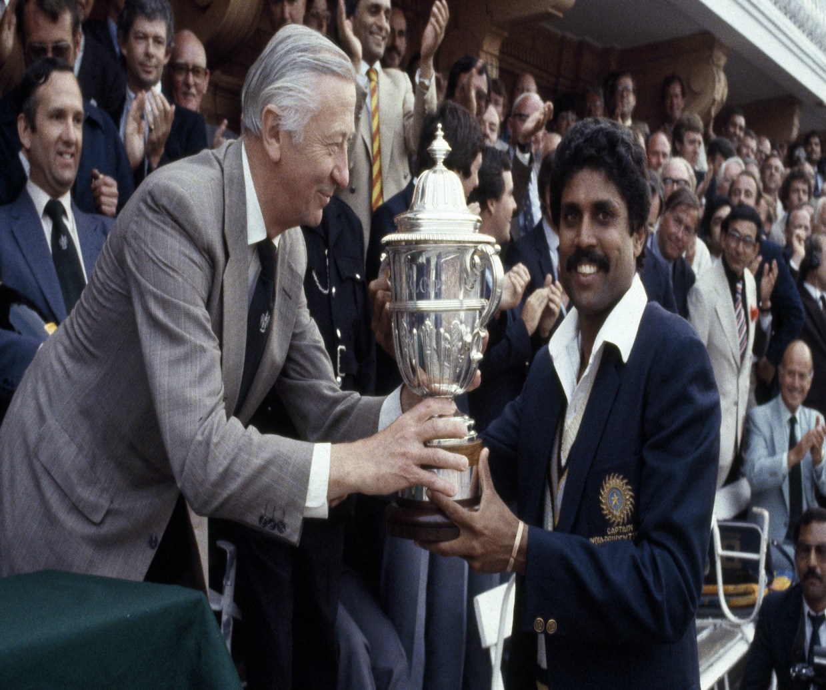
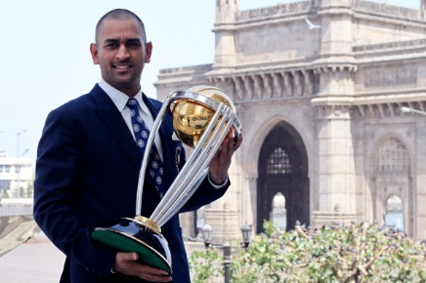
Year Repetition: Hope everyone would have remembered the scenario during world cup 2011 as there was a saying India previously won the world cup during 1983 and the calendar year for both the year is same so india will win the world cup was the most circulated message during those time. Is it true? If that is true how can we find the year repetition after how many years will it repeat?

Slide 9
Let us assume jan 1 1983 is Monday
Year | Day | Year | Day | Year | Day | Year | Day
1984 | Tues | 1993 | Sun | 2002 | Thurs | 2011 | Mon
1985 | Thurs | 1994 | Mon | 2003 | Fri | 2012 | Tues
1986 | Fri | 1995 | Tues | 2004 | Sat | 2013 | Thurs
1987 | Sat | 1996 | Wed | 2005 | Mon | 2014 | Fri
1988 | Sun | 1997 | Fri | 2006 | Tues | 2015 | Sat
1989 | Tues | 1998 | Sat | 2007 | Wed | 2016 | Sun
1990 | Wed | 1999 | Sun | 2008 | Thurs | 2017 | Tues
1991 | Thurs | 2000 | Mon | 2009 | Sat | 2018 | Wed
1992 | Fri | 2001 | Wed | 2010 | Sun | 2019 | Thurs

Slide 10
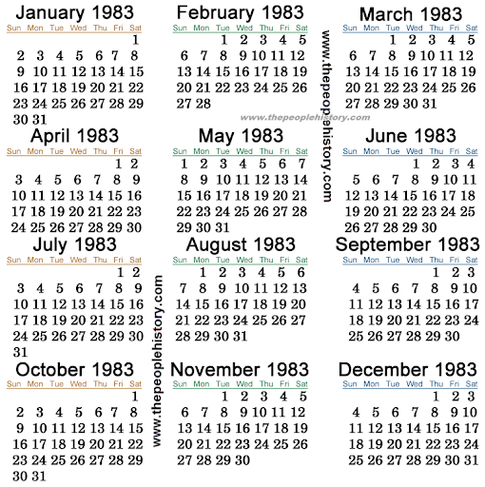
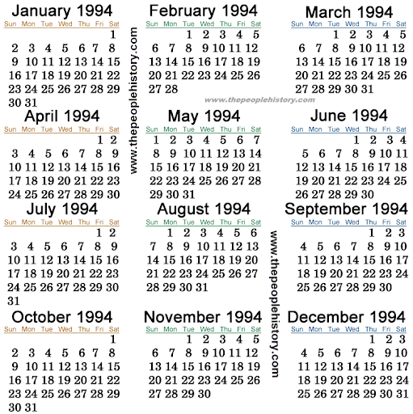
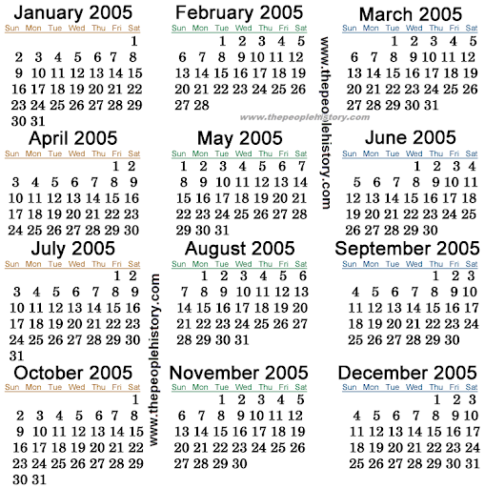
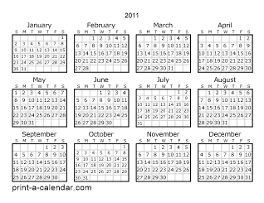

Slide 11
When will 1947 calendar repeat
Year | Day | Year | Day | Year | Day
1947 | 1 | 1951 | 1 | 1955 | 1
1948 | 2 | 1952 | 2 | 1956 | 2
1949 | 1 | 1953 | 1 | 1957 | 1
1950 | 1 | 1954 | 1 | Sum of odd days | 14(0)
so 1947 calendar will be same as 1958 calendar

Slide 12
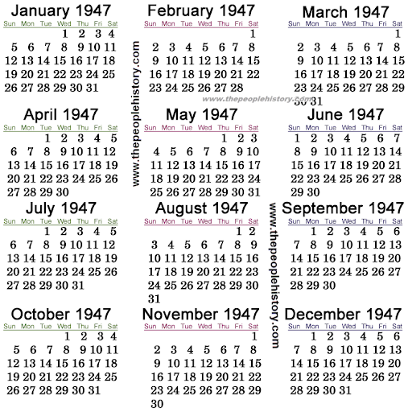
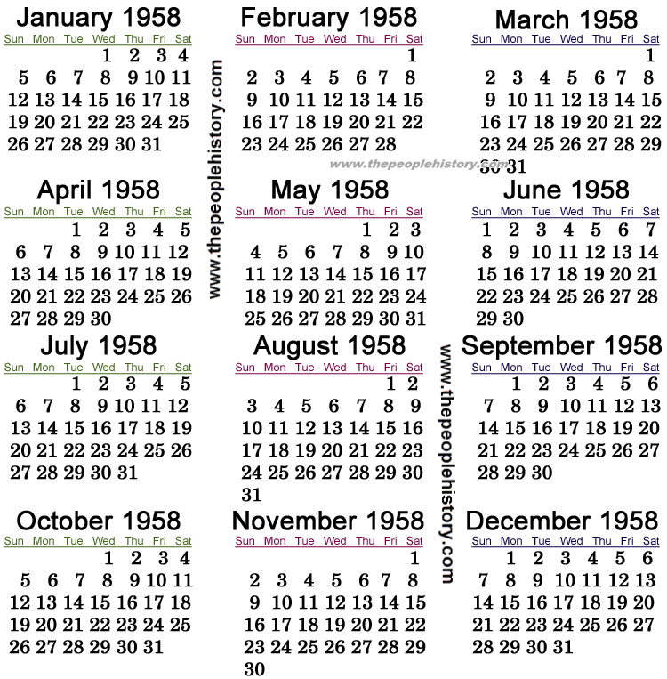

Slide 13
Predicting the future day based on the given scenerio
Example: If 1st day is Wednesday . Then what will be 240th day.
Solution: No.of odd days = 240-1 = 239 = 239/7 = (1 odd day)
Answer: Thursday
Example: If 1st April 2020 is Saturday. Then what will be the day on 26th august 2020.
Solution: No.of odd days
April – 1
May – 3
June – 2
July – 3
August – 26 – 5
Total odd days = 1+3+2+3+5 = 14 ( 0 odd day) . So the same day will repeat.
Answer: Saturday

Slide 14
Predicting the future day based on the given scenerio
Example: If 1st March 2021 is sunday . Then what will be 1st March 2024.
Solution: 1st March 2022 – Monday 1st March 2023 – Tuesday
1st March 2024 - Thursday
Example: If 21st Jan 2016 is Saturday. Then what will be the day on 26th Jan 2020.
Solution: 21st Jan 2017 – Monday 21st Jan 2018 – Tuesday
21st Jan 2019 – Wednesday 21st Jan 2020 - Thursday

Slide 15
Finding the day for the given date.
India got independence on 15th August 1947. On what day did it fall?
Year | Odd Day
100 years | 5 odd days
200 years | 3 odd days
300 years | 1 odd day
400 years | 0 odd day

Slide 16
Month | No.of.days | No.of.odd days
January | 31 | 3
February | 28/29 | 0/1
March | 31 | 3
April | 30 | 2
May | 31 | 3
June | 30 | 2
July | 31 | 3
August | 31 | 3
September | 30 | 2
October | 31 | 3
November | 30 | 2
December | 31 | 3
Odd day | Day
0 | Sunday
1 | Monday
2 | Tuesday
3 | Wednesday
4 | Thursday
5 | Friday
6 | Saturday

Slide 17
Steps to be followed:
Find odd days separately for day, month and year. For our question Day-15, Month August(8), Year – 1947
1. Odd days for year:
Always consider only the fully completed year – here 1947 is still not completed. Completed year – 1946
Splitting the year in three cases [1600+300+46]
Then we know every 400 years the calendar will repeat (or) 400 years has 0 odd days. So remove the nearest
Multiple of 400 from the above year.
Then we know odd days for 100,200,300 years so separate will the nearest known value.
Third case 46 denotes the year from 1901 – 1946 . In that 46 years there are leap years as well as ordinary year so we
must separate leap and non leap years. In order to find the leap years just divide the last two values by 4 and take the integer
Value of the quotient.
46/4 = 11 is the integer quotient so 11 leap years and 35 non leap years. Leap year = 2 odd days, ordinary year – 1 odd day
So the odd days in this case = 11*2+35*1 = 57 = 57/7 = 1
So now odd days for 1600=0
300 = 1
46 = 1 Total odd days for years = 0+1+1 = 2 odd days
2. Odd days for month:
Month = August (8) so 7 months are completed (January to July)
Calculate odd days from January to July = 3+0+3+2+3+2+3 = 16 = 16/7 = 2 odd days

Slide 18
3. Odd days for day:
Take the day directly and find the number of odd days.
Here day = 15 so 15 odd days = 15/7 = 1 odd day
Finally find the sum of all the odd days of day,month and year.
2+2+1 = 5 odd days
5 Represents - Friday
Odd day | Day
0 | Sunday
1 | Monday
2 | Tuesday
3 | Wednesday
4 | Thursday
5 | Friday
6 | Saturday

Slide 19
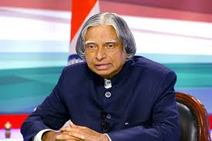
Finding the day for the given date.
On what day did Dr. A.P.J Abdul Kalam was born. (date of birth: 15.10.1931)
Year | Odd Day
100 years | 5 odd days
200 years | 3 odd days
300 years | 1 odd day
400 years | 0 odd day

Slide 20
Month | No.of.days | No.of.odd days
January | 31 | 3
February | 28/29 | 0/1
March | 31 | 3
April | 30 | 2
May | 31 | 3
June | 30 | 2
July | 31 | 3
August | 31 | 3
September | 30 | 2
October | 31 | 3
November | 30 | 2
December | 31 | 3
Odd day | Day
0 | Sunday
1 | Monday
2 | Tuesday
3 | Wednesday
4 | Thursday
5 | Friday
6 | Saturday

Slide 21
15. 10. 1931
[1]
[0]
[3]
15 days
Odd days = 15/7
R(1) = 1 odd day
1930
Since the month is October . Add all the odd days of each month
From january to September
Odd days = 3+0+3+2+3+2+3+3+2 = 21 = 0 odd day.
1600
300
30
[0]
[1]
[1901-1930]
7 – leap years
23 – non leap years
To split the third part divide the value by 4 and take the quotient to find the leap years. .
30/4 → Quotient – 7 , Remainder- 2
So 7 will be the no.of leap years, 30-7 = 23 will be the number of non leap years.
Odd days = 7*2+23*1 =14+23 = 37 = 37/7 = R(2)=2 odd days
[2]

Slide 22
Odd day | Day
0 | Sunday
1 | Monday
2 | Tuesday
3 | Wednesday
4 | Thursday
5 | Friday
6 | Saturday

Slide 23

Few Facts about Calendars:
Last day of the century year cannot be Tuesday , Thursday or Saturday.
April & July for all years and January and October for non-leap years have the same calendar.
March and November though it has 31 and 30 days respectively the day from 1 to 30 will be exactly same during all the year.
Calendar year of a Non Leap year repeats either after 6 years or 11 years.
Calendar year of a Leap year repeats after 28 years.

